Slide 1
POLIO VACCINATION INEQUITY
A Topological Exploration

Slide 2
Purpose of Study
Polio is a disease that causes paralysis and in some cases can be fatal.
Prior to the invention of the vaccination, Polio caused paralysis in more than 150,000 people in the United States each year.
Since the invention of the vaccine, cases of Polio have decreased worldwide by over 99%.
There is an effort to eradicate polio globally, however the CDC speculates that Polio cases could rebound if the eradication effort is unsuccessful.
Our aim was to study World Health Organization vaccination data with TDA techniques to identify potential inequity in vaccination rates worldwide.

Slide 3
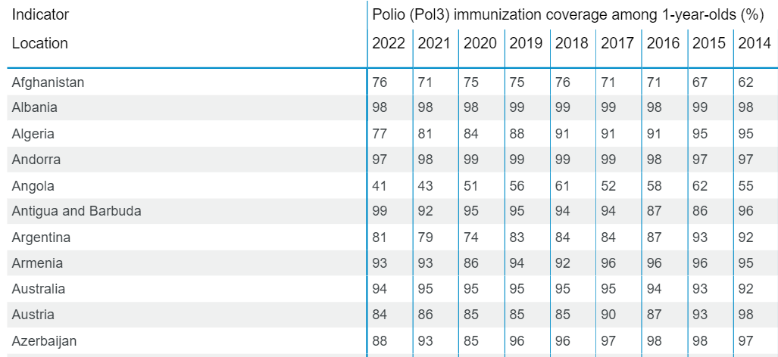
The Data
Vaccination Data from the World Health Organization
Reported by country as a percentage of 1 year olds vaccinated for Polio

Slide 4
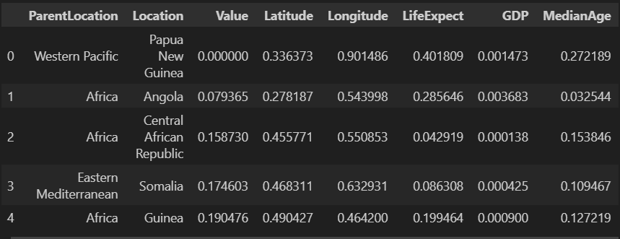
Preprocessing
Gathered latitude and longitude coordinates as well as data from various other sources on GDP, life expectancy, and median age and merged with original dataset.
Performed min/max scaling by column
Filtered dataset to include 2022 data

Slide 5
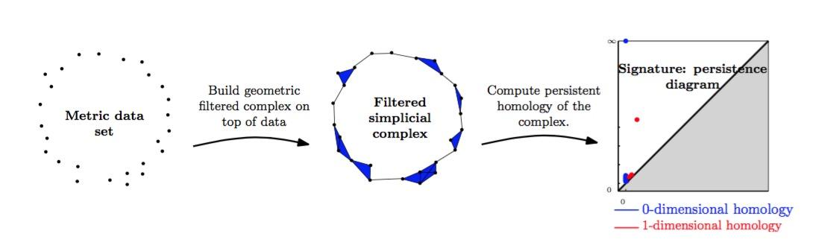
Methods
The main task in exploring our data with persistent homology was thoughtful design of a filtration.
We designed two filtrations
Weighted Alpha Complex
Sub-level Set

Slide 6
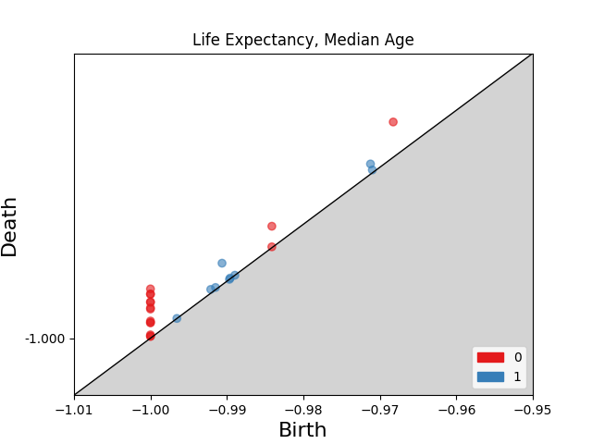
Weighted Alpha Complex Filtration
We used vaccination rates as the weight.
This should make the countries with lower vaccination rates connect more slowly than those with higher rates.
Removed geography as a factor and did a pairwise comparison of all factors.
  Factors used were: Median Age, Life Expectancy, and GDP

Slide 7
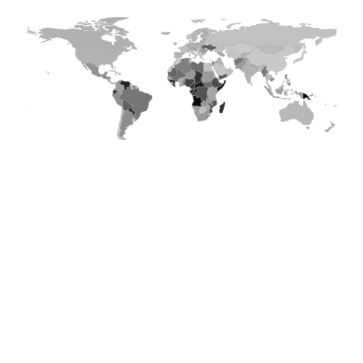
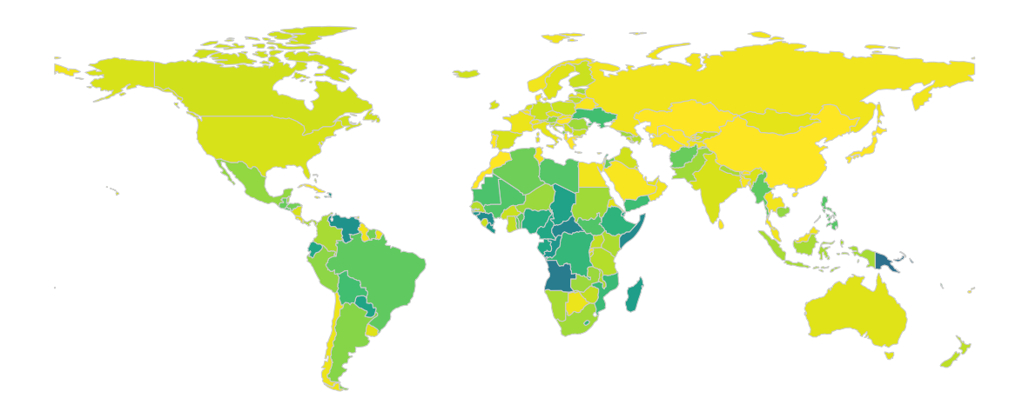
Sublevel Image Filtration
Often times when computing persistent homology, you lose quite a bit in the way of explainability
Wanted to use a sub-level set image filtration as a strategy because there is a way to keep track of creators of 0-homology classes.
Colored a world map by vaccination value and padded to make square.

Slide 8
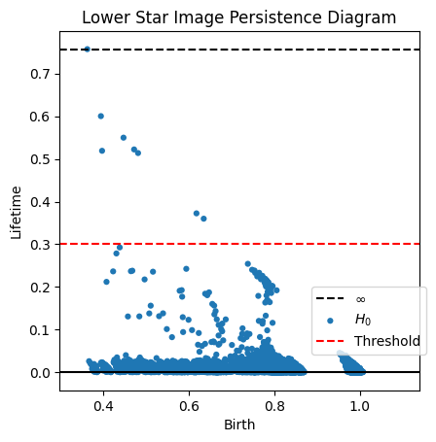
Keeping Track of Creators
When performing a sublevel set filtration on an image, the birth times of persistence points are actually pixel values.
Add random noise to each pixel to ensure that each pixel has a unique value
Compute persistent homology using Scikit-TDA’s lower star image function
Choose a threshold lifetime value
Trace points with high persistence back to the original image by identifying pixels that have the same value as the persistence points’ birth times.

Slide 9
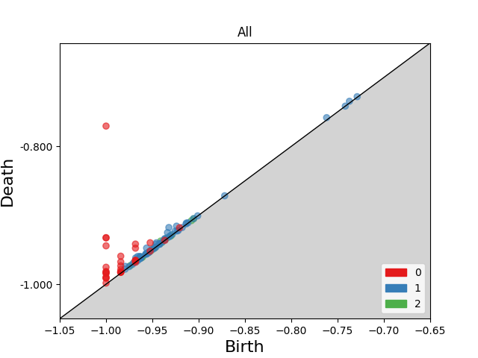
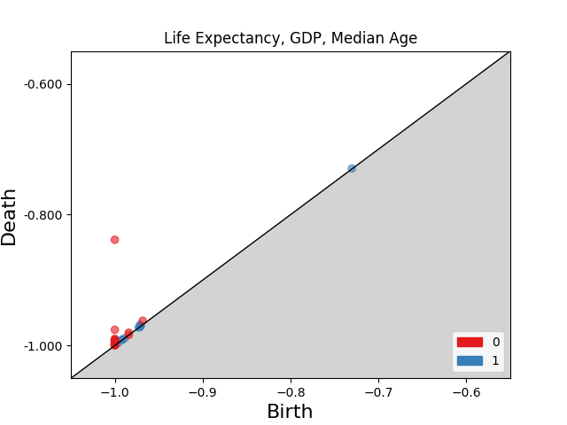
Alpha Complex Results
Note that the 2 persisting components exist even when geography is not an included factor
Analysis of pairwise factor comparison yielded no additional insight

Slide 10
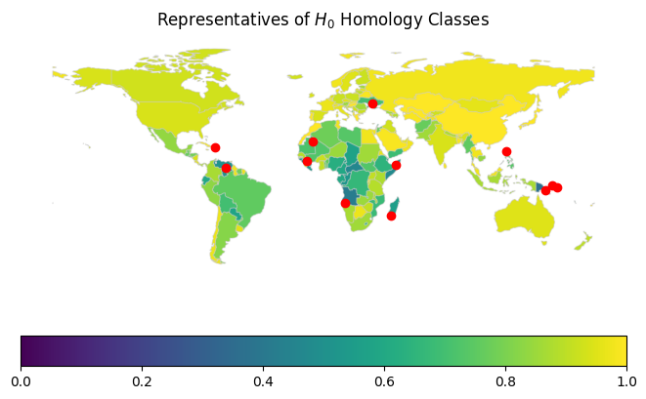
Results
Able to visually identify countries with lower vaccination rates than surrounding region.
Not equivalent to sorting the original data by vaccination value.
Visually:
  Haiti/DR
  Venezuela
  Madagascar
  Angola
  Ukraine
  Philippines
  Papua New Guinea

Slide 11
Suggested Further Study
Develop a method to assign creators to country names so that the visual representation is unnecessary.
Apply the same technique as the sublevel image filtration to different geographical data, for example county election data.
Apply different weights to the weighted alpha complex.
Develop a method for tracing homology diagrams back to specific pieces of data.

